Slide 1


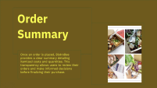





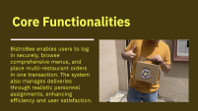



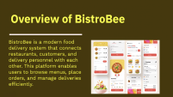



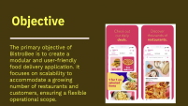
BistroBee: Your Personalized Food Ordering System
Team: Ponnuru Venkata Naga Sai Yaswanth (AP23110010528) Siddi Sathvik Kuruba (AP23110010516) Rajesh Ponnada(AP23110010519) Ratan Raj (AP23110010515)

Slide 2


Slide 3


Slide 4


Slide 5


Slide 6


Slide 7
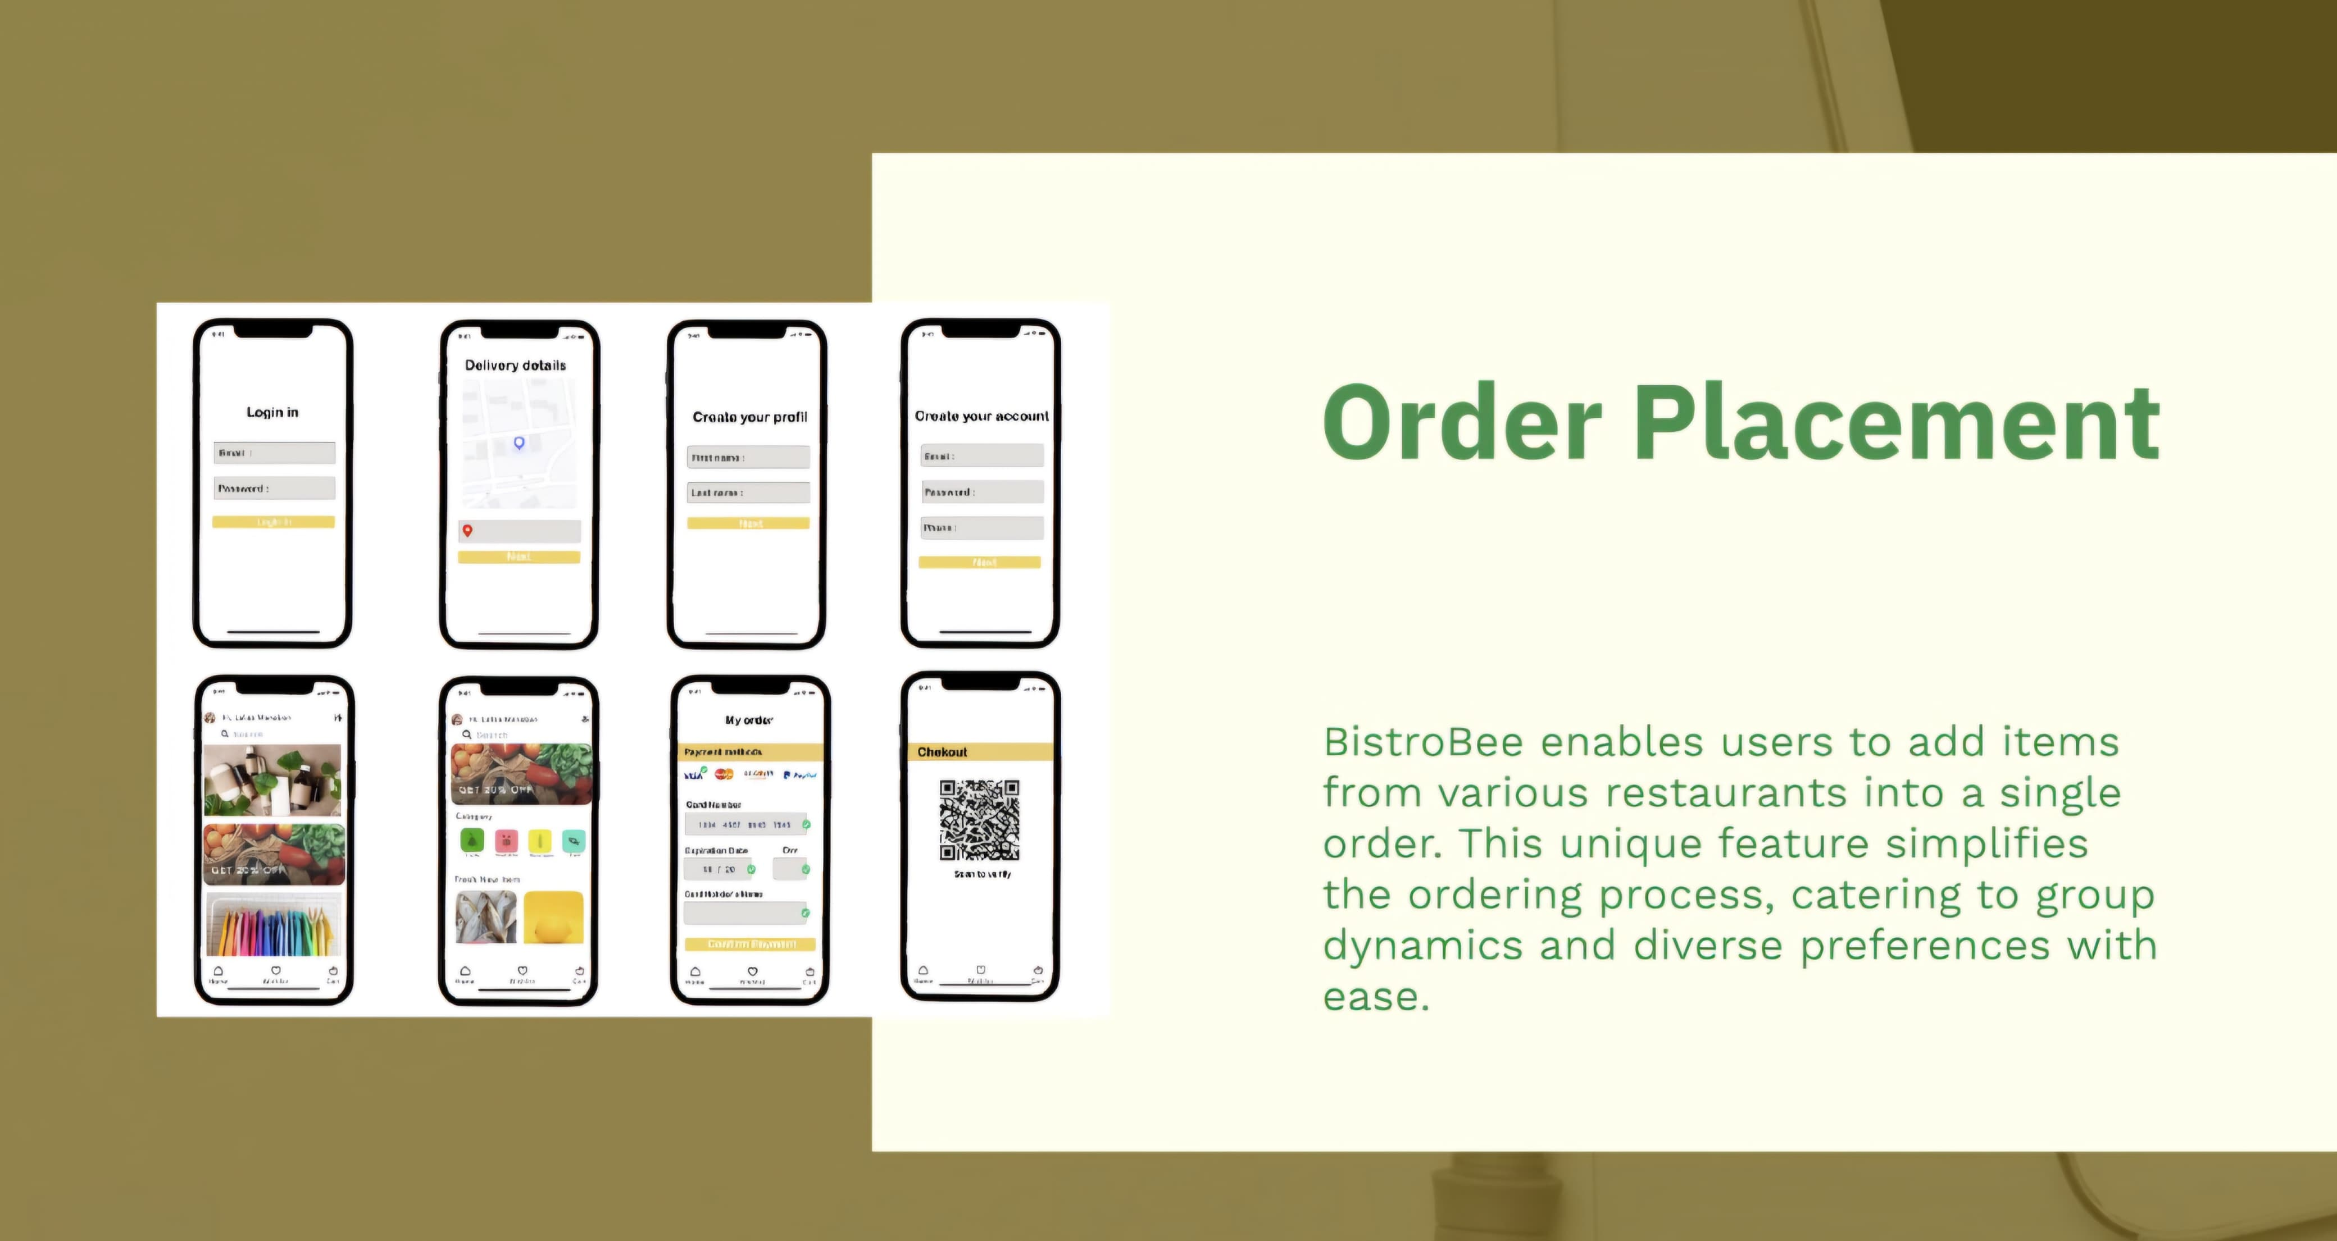

Slide 8


Slide 9
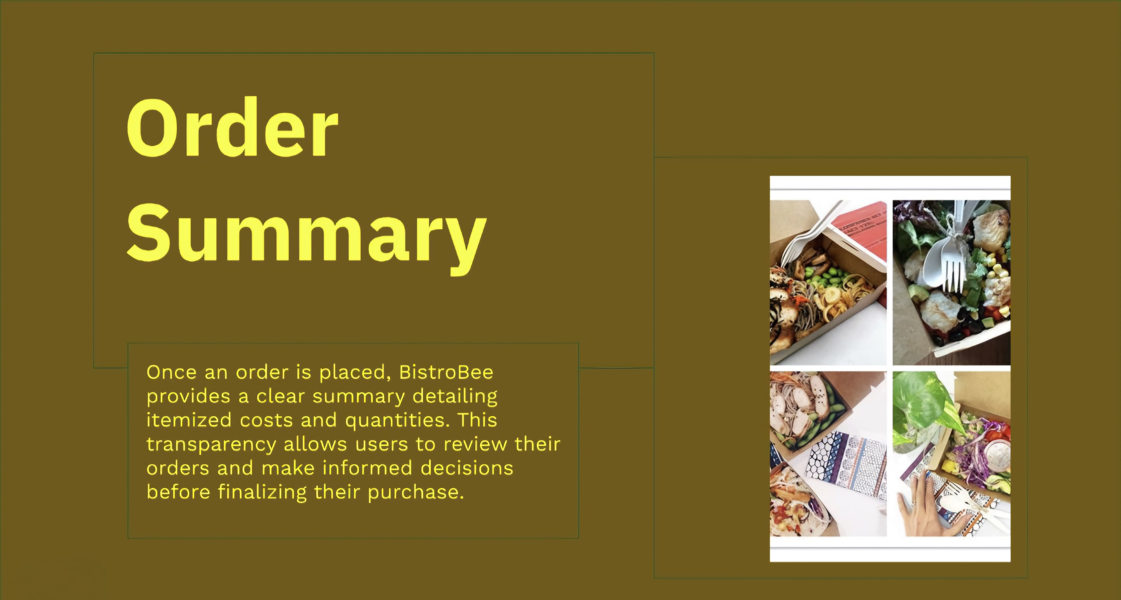

Slide 10
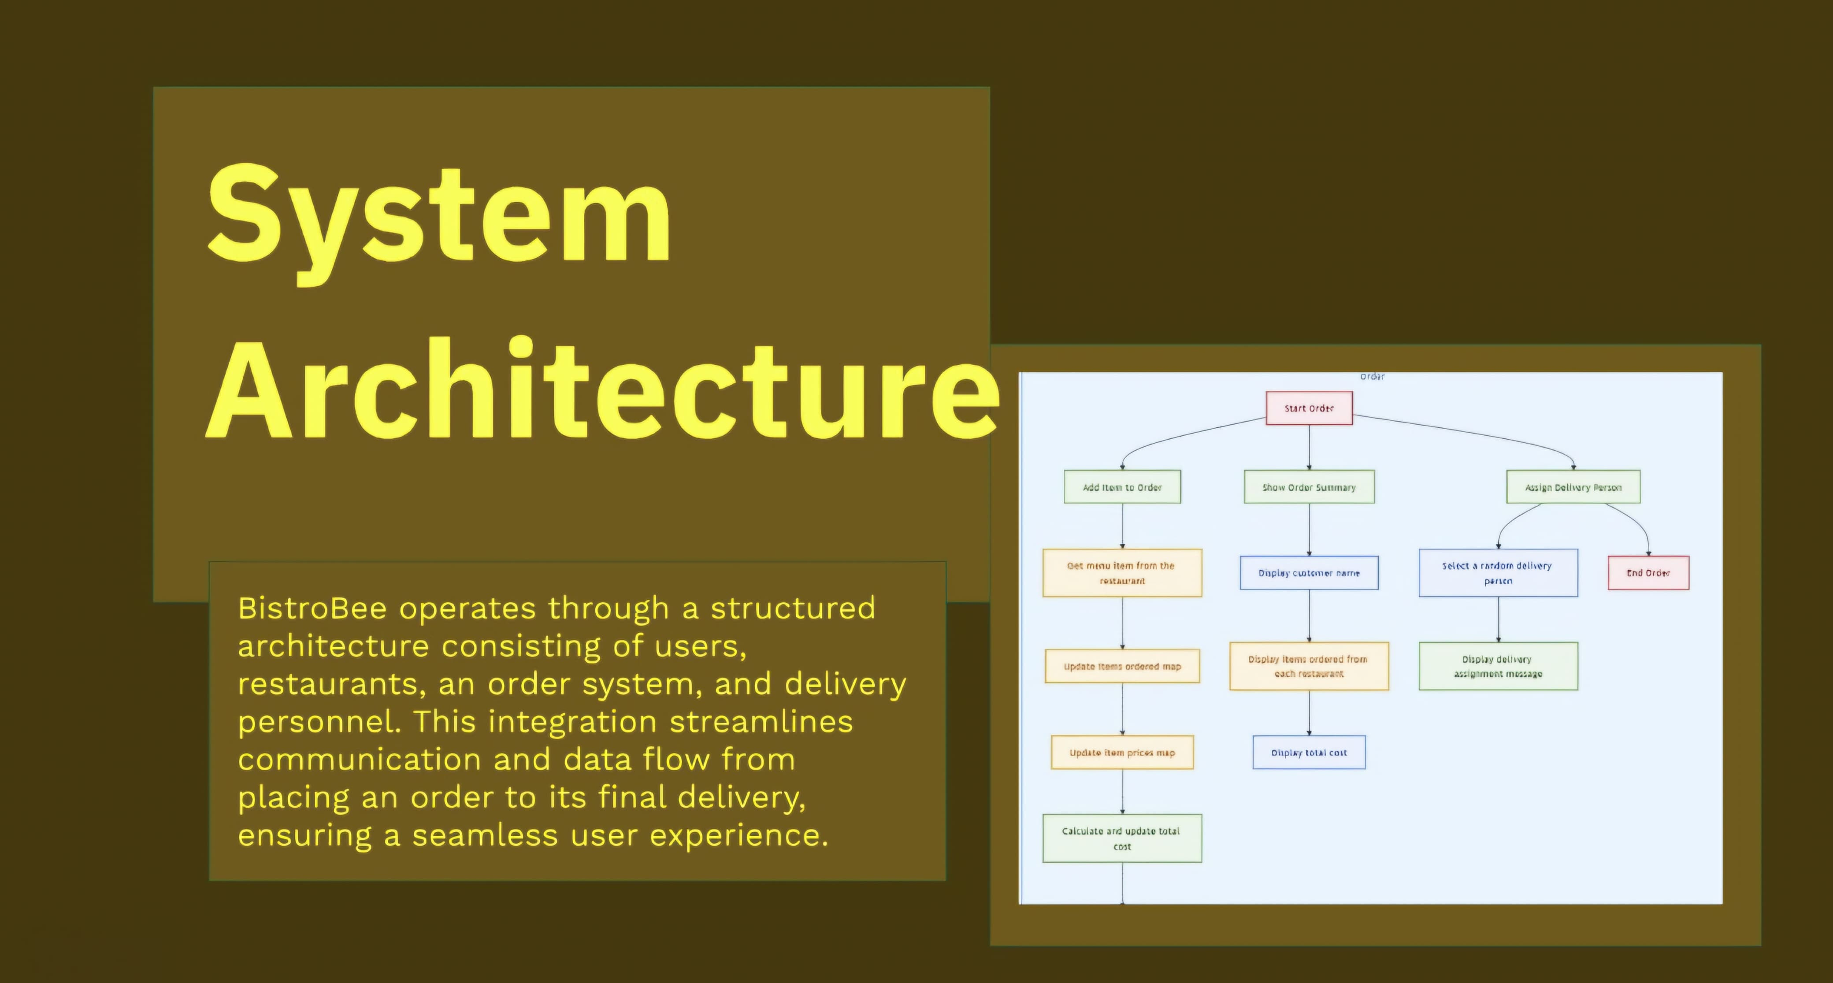

Slide 11


Slide 12
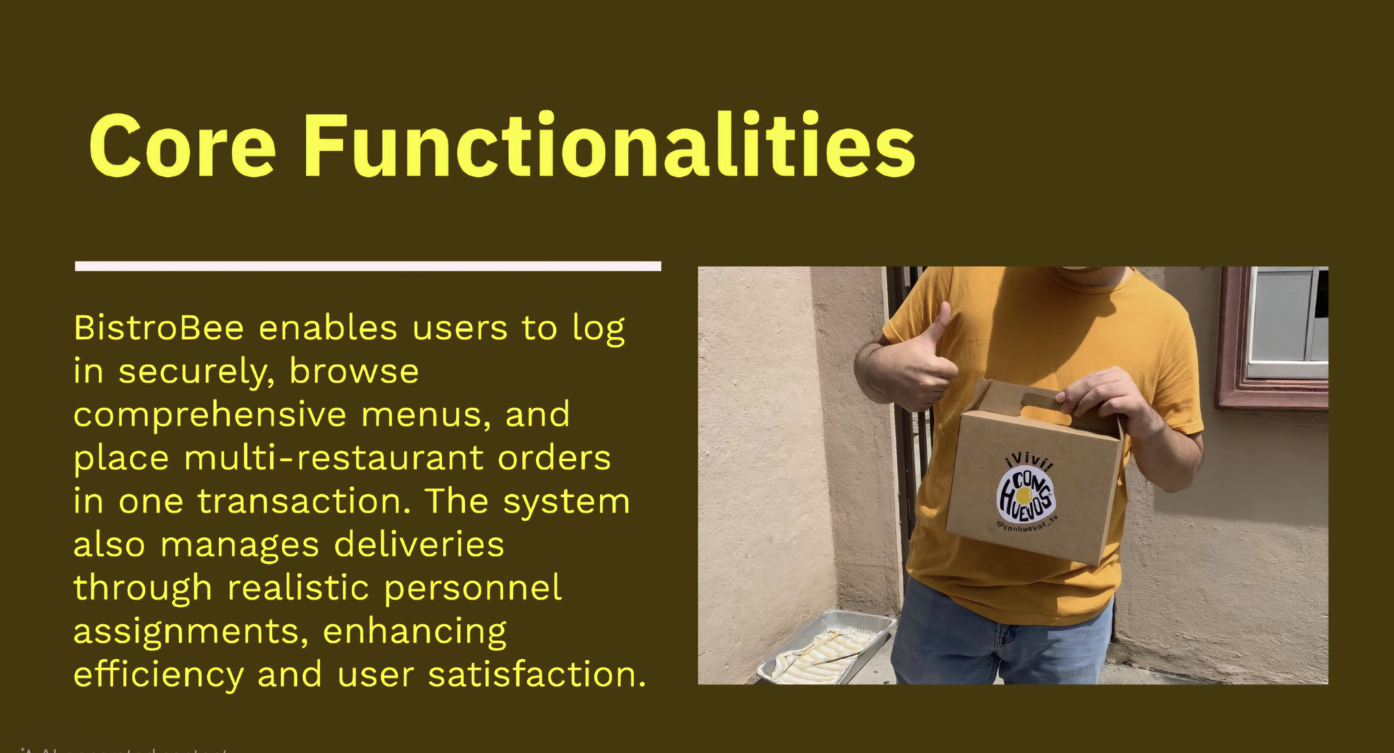

Slide 13


Slide 14


Slide 15


Slide 16


